Slide 1
Security- Case Study
-Yilian Zhang

Slide 2
One way to think about it
cybersecurity = availability, integrity and secrecy of information systems and networks in the face of attacks, accidents and failures with the goal of protecting operations and assets

Slide 3
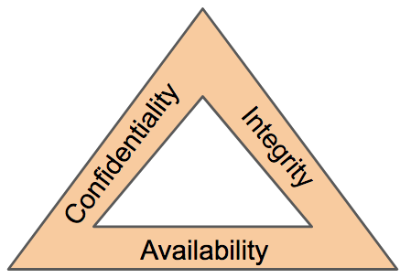
CIA Triad – Model for security community
Confidentiality
Integrity
Availability

Slide 4
Confidentiality
Preserving authorized restrictions on information access and disclosure, including means for protecting personal privacy and proprietary information.
Are the following a violation of confidentiality?
Not knowing someone’s exact salary but knowing that the salary falls in a particular range or exceeds a particular amount
Knowing that a company is developing a certain new product or that talks are underway about the merger of two companies
Credit companies have access to name of items you purchased at a grocery store.
And what about a military food order?

Slide 5
Integrity
Guarding against improper information modification or destruction and ensuring information non-repudiation and authenticity.
Data Integrity – The property that data has not been altered in an unauthorized manner. Data integrity covers data in storage, during processing, and while in transit.
System Integrity – The quality that a system has when it performs its intended function in an unimpaired manner, free from unauthorized manipulation of the system, whether intentional or accidental

Slide 6
Discussion
Are the following a violation of Integrity?
A number of years ago a malicious macro in a Word document inserted the word “not” after some random instances of the word “is”
Any other examples?
Do you do checksum when you download a file from internet?

Slide 7
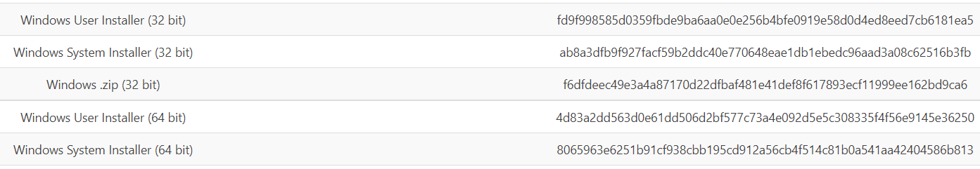
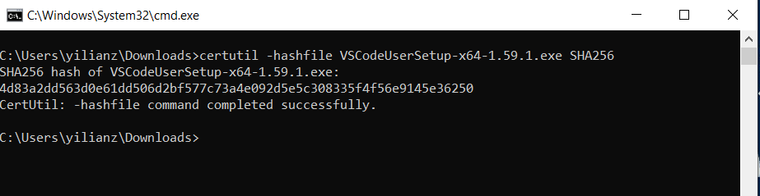
Quick Example on check-sum utility
1. Download a file on https://code.visualstudio.com/Download#
2. Find the checksum value of original file on website
3. Use the window build in utility to compute SHA256. Compare two values.

Slide 8
Availability
ability of a system to ensure that an asset can be used by any authorized parties
What does availability imply?
Access gets slower and slower; the computer responds but not in a way we consider normal or acceptable.
The service is completed in an acceptable period of time.
The data is present in a usable form.

Slide 9
Security Mindset
Security is a mindset
A mindset that how to circumvent designers intent by violating designer's assumptions
Most security vulnerabilities are "outside" of technical design
Security = break assumptions
Security = Do not trust
The security mindset isn’t something that can be taught directly.
Expose Yourselves to open-ended challenges

Slide 10
Case Study: Aiken County Property Tax website
https://acwebegs.aikencountysc.gov/EGSV2Aiken/index.jsp?refresh=true
https://www.aikencountysctax.com/#/
Confidentiality:
Access Control----only authorized individuals gain access to information or systems necessary to undertake their duties---- Policy
Who can access the data ?
What can they access?
When can they access?
Are there any confidentiality failures?
How about Columbia County? https://columbiacountytax.com/#/

Slide 11
Case Study: Aiken County Property Tax website
Integrity: ensure that an asset is modified only by authorized parties
Who can modify the record?
How to modify the record?
Are there any integrity failure?
• precise
• accurate
• unmodified
• modified only in acceptable ways
• modified only by authorized people
• modified only by authorized processes
• consistent
• internally consistent
• meaningful and usable

Slide 12
Case Study: Aiken County Property Tax website
There is a timely response to our request.
Resources are allocated fairly so that some requesters are not favored over others.
Concurrency is controlled; that is, simultaneous access, deadlock management, and exclusive access are supported as required.
The service or system involved follows a philosophy of fault tolerance, whereby hardware or software faults lead to graceful cessation of service or to work-arounds rather than to crashes and abrupt loss of information. The service or system can be used easily and in the way it was intended to be used.
Availability
Is there a timely response?
Is it present in a usable form?
Are there faulty tolerance?

Slide 13
Case Study: Aiken County Property Tax website
Discussion:
Can you propose a better solution ?
Now, let try one in discussion board.
https://uscaiken.formstack.com/forms/daily_screening_covid19
https://www.usca.edu/registrar/forms/declare-or-change-a-major-or-concentration-form

Slide 14
Recent Case
https://www.cshub.com/attacks/news/student-loan-data-breach-leaks-25-million-social-security-numbers
Student loan data breach leaks 2.5 million social security numbers
It was concluded by the investigation on 17 August that, due to the vulnerability, student loan account registration information including name, address, email address, phone number and social security number, was accessible to an unknown third party staring in June and ending on 22 July 2022.
https://apps.web.maine.gov/online/aeviewer/ME/40/f6b4d5be-f7ef-412b-9966-e323ad6443a0.shtml

Slide 15
Characteristic of Security Professional
From Article: https://www.ncbi.nlm.nih.gov/pmc/articles/PMC6005833/#B2
Key Traits in the Future of the Cyber Workforce
Systemic Thinkers
Team Players
Technical and Social Skill
Communications
Continued Learning
Civic Duty

Slide 16
Access Control ( Authorization)
Authorization is any mechanism by which a system grants or revokes the right to access some data or perform some action.
limiting who can access what in what ways
File permissions, such as the right to create, read, edit or delete a file.
Program permissions, such as the right to execute a program.
Data permissions, such as the right to retrieve or update information in a database.
Try it: Who can read your file on J:/drive , K:/drive?

Slide 17
Authentication
Authentication is any process by which a system verifies the identity of a user who wishes to access the system.
Typically: User Name and Password
the act of proving that asserted identity: that the person is who she says she is.

Slide 18
Identification
Act of asserting who a person is.
Is your identities private? --Identities are typically public or well known
Discussion:
email account ID
bank account number
Your phone number
Your zip code
Social Security Number
Birth day date

Slide 19
Case Study: Vice Presidential Candidate Sarah Palin’s Email Exposed
During the 2008 U.S. presidential campaign, vice presidential candidate Sarah Palin’s personal email account was hacked. Contents of email messages and Palin’s contacts list were posted on a public bulletin board. A 20-year-old University of Tennessee student, David Kernell, was subsequently convicted of unauthorized access to obtain information from her computer and sentenced to a year and a day.
How could a college student have accessed the computer of a high-profile public official?

Slide 20
User ID : public
Governor Palin’s email account was gov.palin@yahoo.com. The account ID was well known because of news reports of an earlier incident involving Palin’s using her personal account for official state communications; even without the publicity the account name would not have been hard to guess.
How to guess the password?

Slide 21
Password --- Reset
But the password? No, the student didn’t guess the password. All he had to do was pretend to be Palin and claim she had forgotten her password. Yahoo asked Kernell the security questions Palin had filed with Yahoo on opening the account: birth date (found from Wikipedia), postcode (public knowledge, especially because she had gotten public attention for not using the official governor’s mansion), and where she met her husband (part of her unofficial biography circulating during the campaign: she and her husband met in high school). With those three answers, Kernell was able to change her password (to “popcorn,” something appealing to most college students). From that point on, not only was Kernell effectively Palin, the real Palin could not access her own email account because did she not know the new password.

Slide 22
Failure of Authentication
User ID - Public
Password
Weak Password
Password Reuse
Password saved by browser
??? Who can access the remembered password – Chrome, Firefox
NISA Password Guidance
https://www.nist.gov/video/password-guidance-nist-0
https://pages.nist.gov/800-63-3/sp800-63-3.html

Slide 23
NIST Password Guidelines
New: Check against passwords obtained from previous breach corpuses.
8 character minimum when a human sets it
No complexity requirements
No password expiration period
No password hints
No knowledge-based authentication (e.g. who was your best friend in high school?)
* Easy to remember and hard to guess, length>>complexity *

Slide 24
Password Requirement in use- Good or Bad
Length and complexity requirements beyond those recommended here significantly increase the difficulty of memorized secrets and increase user frustration. As a result, users often work around these restrictions in a way that is counterproductive. Furthermore, other mitigations such as blacklists, secure hashed storage, and rate limiting are more effective at preventing modern brute-force attacks. Therefore, no additional complexity requirements are imposed. – From NIST 800-63B

Slide 25
Is your email compromised?
https://haveibeenpwned.com/

Slide 26
Is your password compromised?
What is the most popular password in the pwned password database?
Try it: Create an easy to remember password that
8 character minimum
And have not been seen on website https://haveibeenpwned.com/Passwords

Slide 27
Password Protection - Difficult
One time Use ------ Supplying a password for each access to an object can be inconvenient and time consuming.
Disclosure------- If a user discloses a password to an unauthorized individual, the object becomes immediately accessible. If the user then changes the password to re-protect the object, the user must inform any other legitimate users of the new password because their old password will fail.
Revocation----- To revoke one user’s access right to an object, someone must change the password, thereby causing the same problems as disclosure.
Loss ----- How to handle loss or forgotten password?

Slide 28
Multi-Factor Authentication (MFA)
Authentication using two or more different factors to achieve authentication. Factors include: (i) something you know (e.g., password/PIN); (ii) something you have (e.g., cryptographic identification device, token); or (iii) something you are (e.g., biometric).
Use MFA whenever possible!!
Common MFA:
swiped your bank card at the ATM and then entered your PIN (personal ID number).
logged into a website that sent a numeric code to your phone, which you then entered to gain access to your account.

Slide 29
Two Factor Auth
https://twofactorauth.org/#
Find a list of websites that offer MFA
Popular Security Action:
Use two-factor authentication

Slide 30
More factors could be a problem
Dave Concannon’s blog describes his frustration at using Ulsterbank’s online banking system. The logon process involves several steps. First, the user supplies a customer identification number (the first authentication factor). Next, a separate user ID is required (factor 2). Third, the PIN is used to supply a set of digits (factor 3), The system requests three different digits chosen at random (in the figure, the third, second, and fourth digits are to be entered). Finally, the system requires a passphrase of at least ten characters, some of which must be numbers (factor 4).
Which CIA rules is not followed?

Slide 31
Password Manager
Encrypted digital vault that stores the login information you use to access websites, apps and other services.
Besides keeping your credentials and sensitive data safe, a password manager can generate unique, strong passwords to ensure you aren't reusing your them across your services.

Slide 32
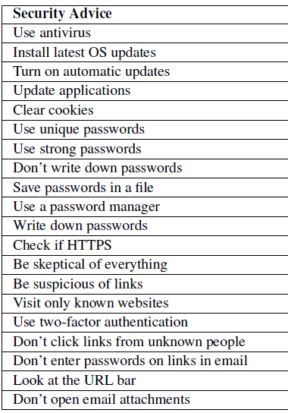
Expert and Non-Expert Security Practice
https://www.usenix.org/system/files/conference/soups2015/soups15-paper-ion.pdf
Security Advice:

